Slide 1
Resource Presentation
Leaflet
Tev’ye Davis

Slide 2
Brief introduction
Create Interactive Web Maps with the JavaScript 'Leaflet' Library.
Useful for data exploration and visualization of data.
They look good! They are not static maps, so you can
Zoom
toggle layers on and off
Add data to base layers

Slide 3
Authors
Main author: Joe Cheng
Chief Technology Officer at RStudio and was the original creator of the Shiny web framework (i.e. interactive web applications with R).

Slide 4
Simple Demonstration
Arguments Description
Map - adds the map
Lng - A numeric vector of longitudes
Lat - a vector of latitudes
Icon - the icon(s) for markers
Label - a character vector of the HTML content for the labels
Graphics elements and layers
addTiles: Add a tile layer to the map
addPopups: Add popups to the map
addMarkers: Add markers to the map
addPolygons: Add polygons to the map

Slide 5
Simple Demonstration
Install the package by
Steps to create a Leaflet map
Create a map widget by calling leaflet().
Add layers (i.e., features) to the map by using layer functions (e.g. addTiles, addMarkers, addPolygons) to modify the map widget.
Repeat step 2 if needed.
Then print the map.

Slide 6
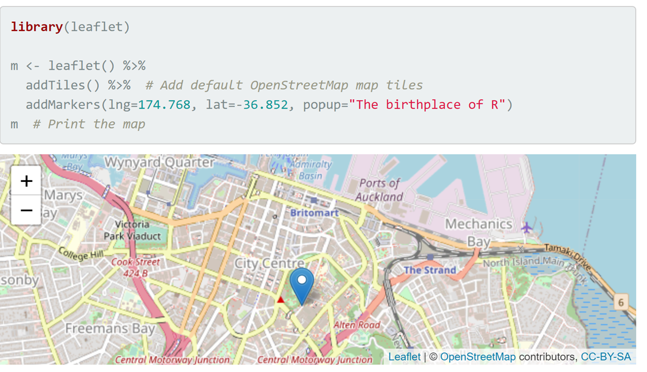
Simple Demonstration

Slide 7
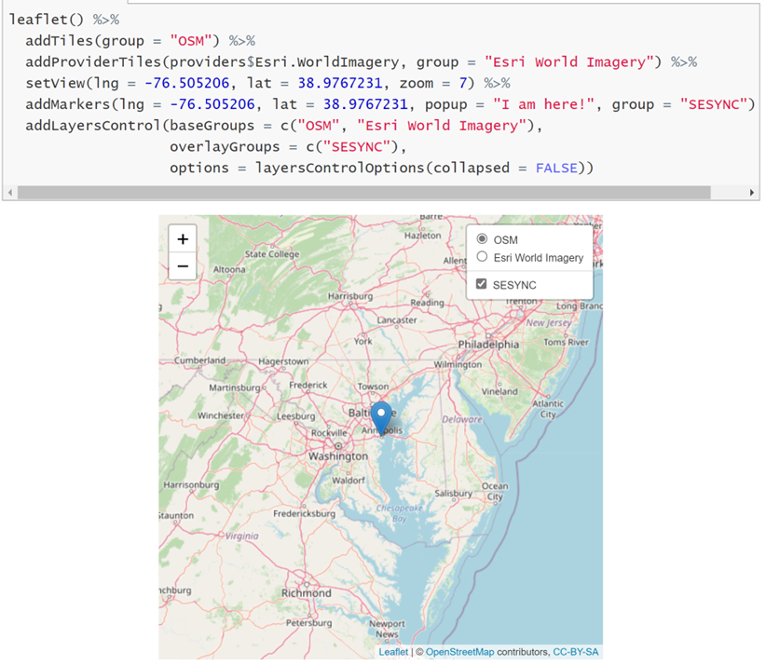
Simple Demonstration

Slide 8
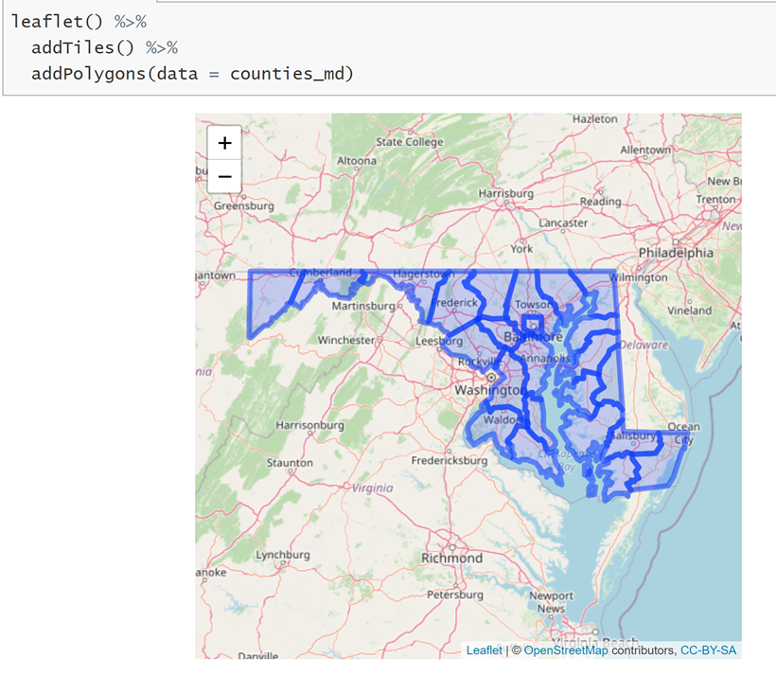
Simple Demonstration

